Slide 1

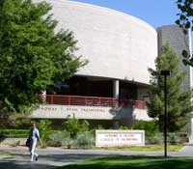
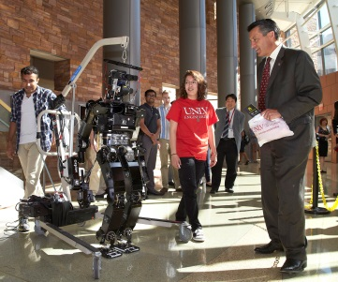
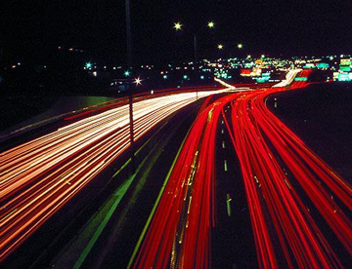

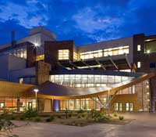
WELCOME to your Spring 2020 senior design!

Slide 2
SENIOR DESIGN COMPETITION
Spring 2020
20th Anniversary of the
Fred & Harriet Cox
Senior Design Competition!
Let’s Roar into our 20th in 2020!

Slide 3
SENIOR DESIGN COMPETITION
Spring 2020
Set up:
Wednesday, May 6, 12pm - 5 pm
Competition:
Thursday, May 7, 8am - 6pm
Location:
Thomas & Mack Complex

Slide 4


Slide 5
PRIZES
**CEEC, CS, ECE, EED & ME
1st - $300 per student team member
2nd - $150 per student team member
**Interdisciplinary
$350 per student team member
*Commercial Potential
$325 per student team member
* Can be won in addition to department awards ** If the category only has one team competing, then the team score must be equivalent to other department scores to receive a prize.

Slide 6
PRIZES
*Sustainability
$225 per student team member
*Popular Choice
$125 per student team member
*Team Congeniality
$100 per student team member
Grand Prize
$500 per student team member
* Can be won in addition to department awards

Slide 7
Professional Team Photos
Professional team photos will be taken at no charge on the dates and times below:
Monday, March 9th: 12pm – 5pm*
&
Tuesday, March 10: 8am – 12pm*
Location is the Great Hall, TBE-A 1st floor. Professional attire for team photo.
*Time slots will be filled as received, these are the only 2 days we will take team photos.

Slide 8
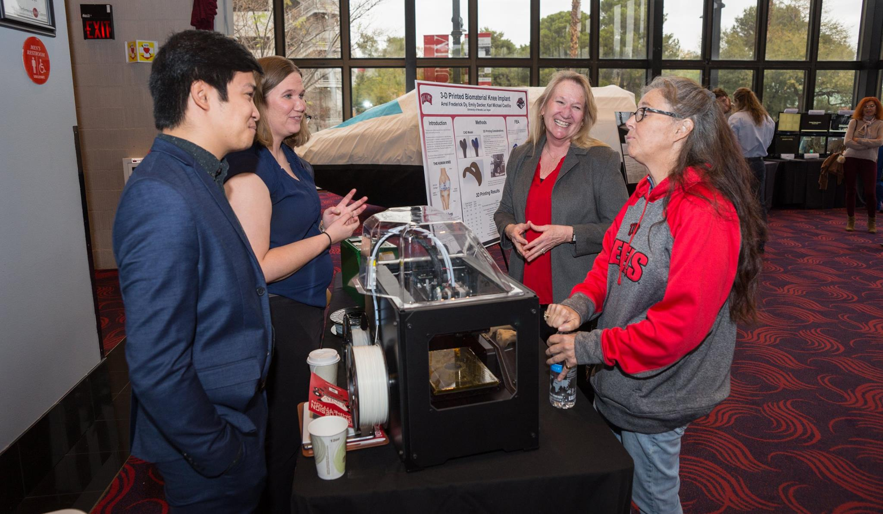
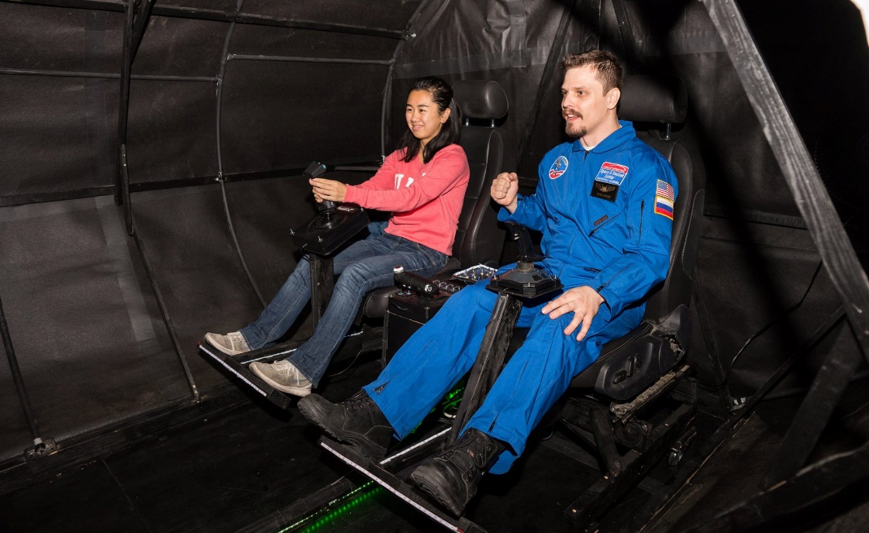
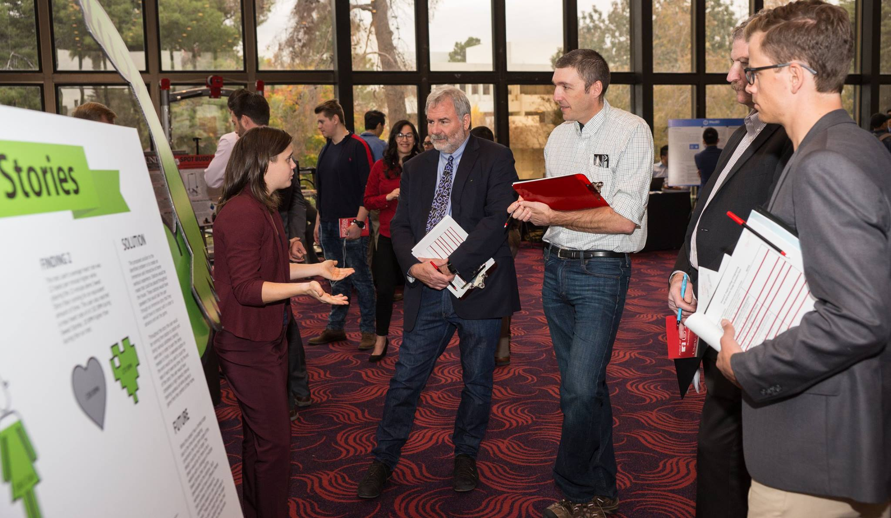
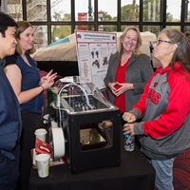

Slide 9

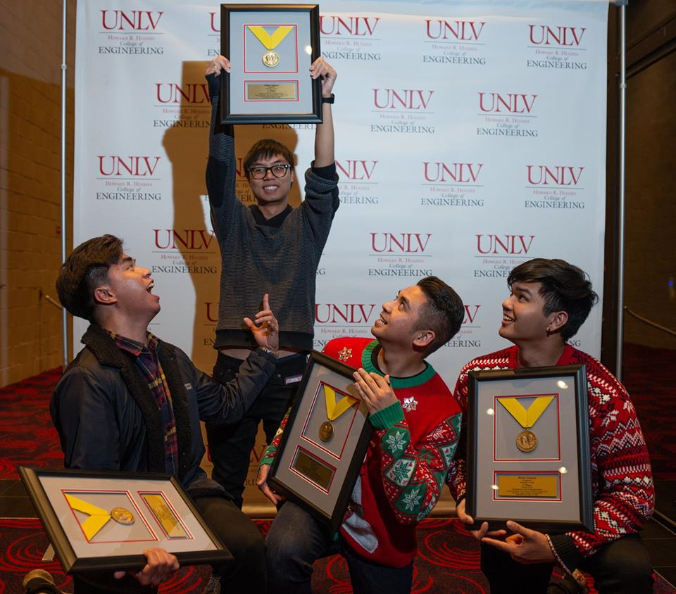
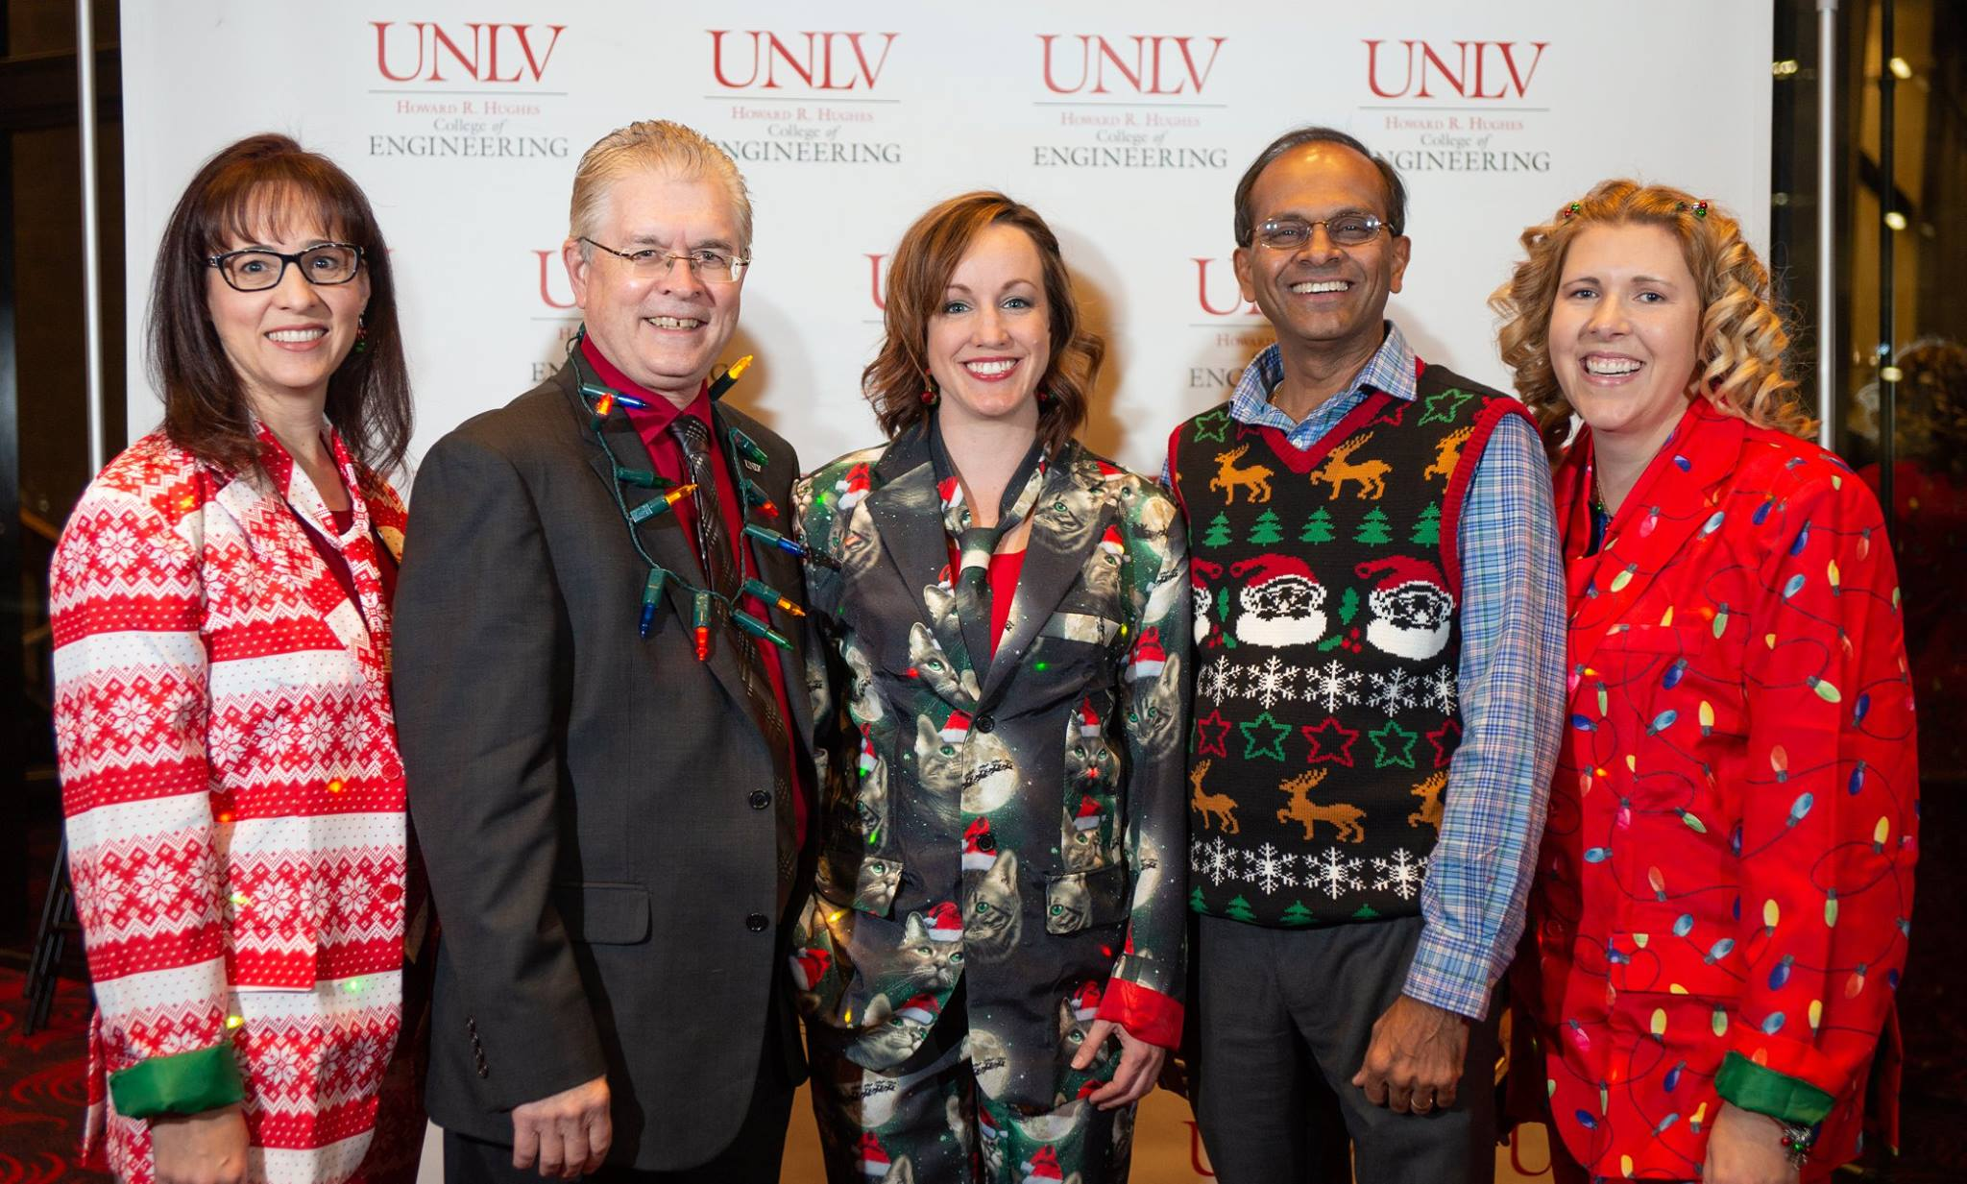

Slide 10

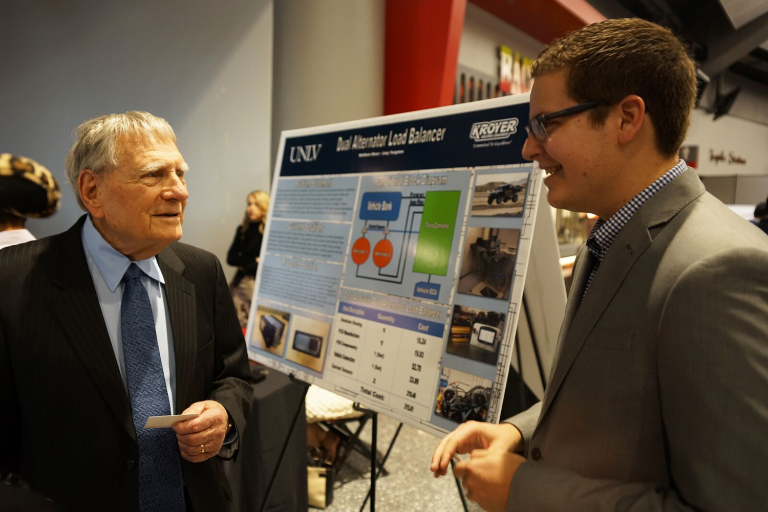
POSTER EXAMPLES
Poster must be professionally mounted on Foam Core to be considered for reimbursement. Reach out to copy services in the student union for pricing and deadlines… DO NOT wait until the last week as they will charge a rush fee.
Poster size: 3ft by 4ft Landscape Layout Mounted on Foam Core
*Take a Picture for Reference!

Slide 11
NON-REIMBURSABLE ITEMS
Clothing
Computers/Laptops/Tablets
Smart Phones/Cell Phones
Printers
Consulting and/or Subcontracting Fees
Website Hosting, Building/Developing, Maintenance, Design, Etc.
Food and beverages
If your team feels that they need to purchase something from the above list please email Molly to see if an exception can be made.

Slide 12
SPECIAL NEEDS ITEMS
You may request specially needed items from this list. We are unable to provide anything beyond the options available:
Electricity (Including number of outlets)
Extra Easels
Extra Space (restrictions due to location of event.)
Extra Tables
Internet (Wired or Wireless)
Outside or inside
Freight Elevator Access (Depending on Venue)
* We do NOT supply: Carts to move items, televisions, monitors, computers, etc.

Slide 13
SPECIAL NEEDS ITEMS
If your team does not request your special needs by the due date (refer to your flyer for due dates), then the special needs WILL NOT be met! It is your teams responsibility to submit your request for anything other than:
1 Table
1 Table Linen
1 Easel
2 Chairs

Slide 14
IMPORTANT DATES/DEADLINES
Jan. 30: Complete Information contact sheet (Molly will email link)
Feb. 12: Project Abstracts/Media blurb - email to Molly as a Word Document, (do not bring a printed copy to Molly’s office)
Feb. 19: Last day to email Molly to schedule a Team Photo
March 9: Professional Photos: 12pm-5pm, TBE-A Great Hall
March 10: Professional Photos: 8am-12pm, TBE-A Great Hall
March 20: Email to Molly to notify of any project special needs, I.e. outside, inside,
extra space, extra outlet, etc.
March 25: Mandatory Poster Workshop (at least 1 team member), Amargosa Room in the Lied Library 2:30pm-3:30pm
TBD: Mandatory Oral Presentation Workshop (at least 1 team member), Location TBE, 2:30pm-3:30pm on a Monday or Wednesday.

Slide 15
IMPORTANT DATES/DEADLINES
April 1: RSVP for awards (link will be provided) student and one guest is free ($50 for additional guests) – MUST RSVP at link if attending
April 1: Presentation times emailed to students
May 6: Set up; Thomas & Mack Complex, 12-5pm
May 7: Competition, 8am-6pm – MUST arrive by 6:30am
May 8: Awards Reception & Dinner, 6:00pm-10:00pm – Thomas & Mack Complex and Cox Pavilion – Teams MUST be present at awards or any earned monetary award will be forfeited.
May 14: Reimbursement packets (receipts) due to your department Administrative Assistant, EED Teams will submit to Marje in the Dean’s Office, TBE-A111. by 4:55pm – NO EXCEPTIONS

